Slide 1
Raising Waters A Machine Learning Approach To Flood Prediction
SlideMake.com

Slide 2
Introduction to Flood Prediction
Flooding poses significant threats to communities, infrastructure, and ecosystems worldwide.
Accurate flood prediction is essential for effective disaster management and mitigation.
Machine learning offers innovative solutions to improve the timeliness and accuracy of flood forecasts.
Notes:
Image source: https://www.researchgate.net

Slide 3
Importance of Flood Prediction
Early warning systems can save lives and reduce economic losses during flood events.
Traditional methods rely on hydrological models that require extensive data and are time-consuming.
Machine learning models can process large datasets quickly to generate real-time flood predictions.
Notes:
Image source: https://www.researchgate.net

Slide 4
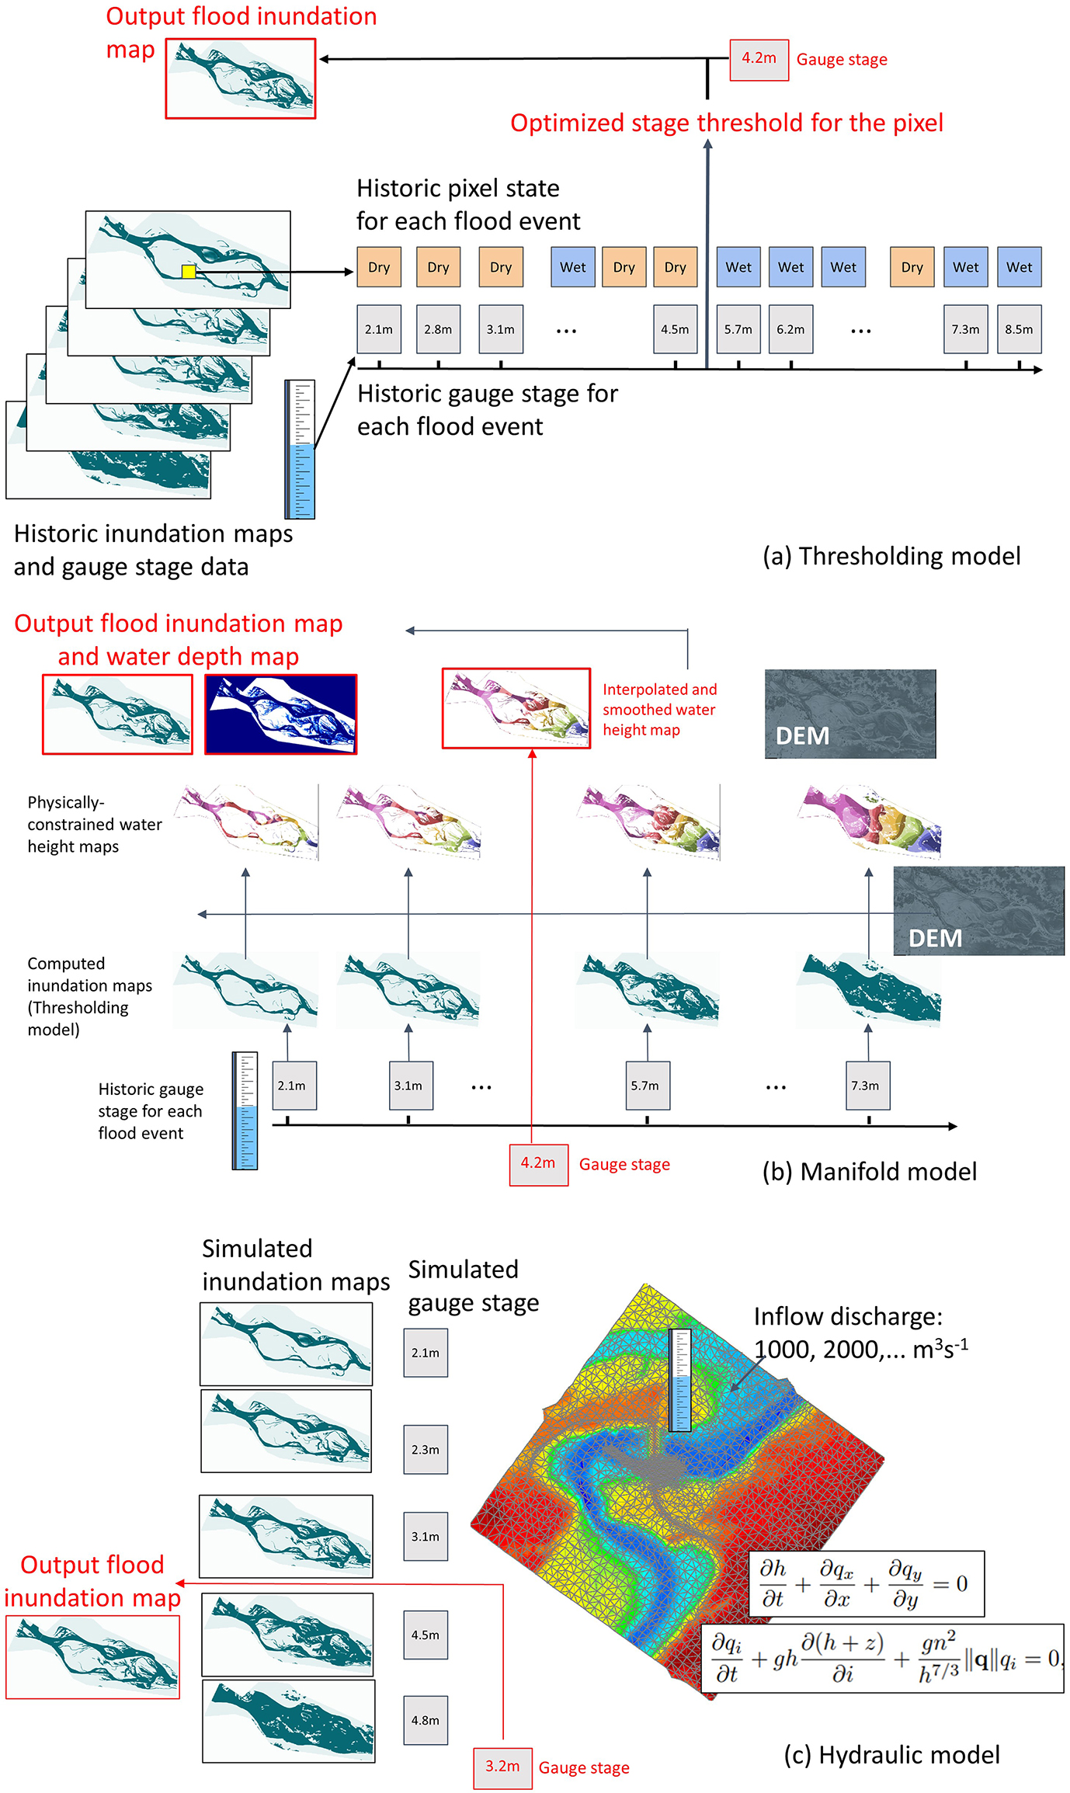
Data Sources for Flood Prediction
Satellite imagery, weather data, and river gauge measurements are primary data sources.
Remote sensing provides spatial and temporal information critical for understanding flood dynamics.
Integrating diverse datasets enhances the robustness and reliability of machine learning models.
Notes:
Image source: https://hess.copernicus.org

Slide 5
Machine Learning Techniques Used
Supervised learning algorithms like Random Forests and Support Vector Machines are commonly applied.
Deep learning models such as Convolutional Neural Networks (CNNs) can analyze satellite images effectively.
Ensemble methods combine multiple models to improve prediction accuracy and reduce uncertainty.
Notes:
Image source: https://www.researchgate.net

Slide 6
Model Development Process
Data preprocessing involves cleaning, normalization, and feature selection to prepare datasets.
Training involves feeding historical data into algorithms to learn flood patterns.
Validation and testing assess the model’s performance and generalizability to new data.
Notes:
Image source: https://www.researchgate.net

Slide 7
Case Studies and Applications
Several regions worldwide have successfully implemented ML-based flood prediction systems.
For example, in Bangladesh, machine learning models have improved early warning accuracy.
These applications demonstrate the potential for scalable and adaptable flood forecasting solutions.
Notes:
Image source: https://www.mdpi.com

Slide 8
Challenges and Limitations
Data quality and availability remain significant hurdles for developing reliable models.
Machine learning models can be sensitive to biases present in training datasets.
Integrating models into existing infrastructure requires careful planning and stakeholder engagement.
Notes:
Image source: https://www.researchgate.net

Slide 9
Future Directions in Flood Prediction
Incorporating real-time sensor data and IoT devices can enhance prediction capabilities.
Combining machine learning with hydrological models offers a hybrid approach for better accuracy.
Continued research aims to develop more interpretable models and user-friendly interfaces.
Notes:
Image source: https://www.researchgate.net

Slide 10
Conclusion
Machine learning has the potential to revolutionize flood prediction and disaster preparedness.
Successful implementation depends on quality data, model validation, and stakeholder cooperation.
Advancements in technology will continue to improve the timeliness and precision of flood forecasts.
Notes:
Image source: https://www.researchgate.net

Slide 11
References & Acknowledgments
Key studies and sources related to machine learning and flood prediction are listed here.
Gratitude is extended to researchers, organizations, and communities contributing to this field.
For further information, contact details and additional resources are provided.

